Slide 1
Welcome to AP Seminar!! ☺
Ms. Overton Room 2608

Slide 2
On your index card:
Name (First & Last)
Parent(s) names, Phone #, & Email
Do you play any sports or participate in any after school activities?
Copy down your schedule for my records.
On the back – Write down your current idea of what all AP Capstone Seminar encompasses.

Slide 3
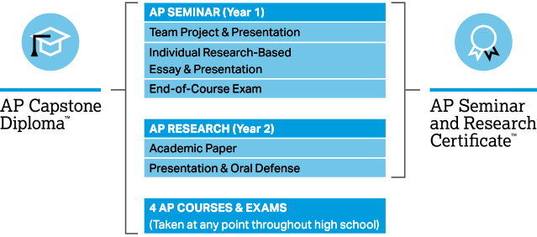
AP Capstone Program

Slide 4
AP Seminar is a student-driven course designed by the AP College Board based off of the skills which colleges said rising freshmen in their schools needed the most. These include public speaking, creating dynamic presentations, collaborating in teams, and writing thorough research papers. All of this is done through researching relevant topics/issues to find plausible solutions as they pertain to society both locally and globally. Students will assess their research questions through different lenses (i.e. Economic, Political, Historical, Scientific, etc), as well as addressing various perspectives on such topics.

Slide 5
Some insight from previous students…
https://drive.google.com/file/d/1eYZYvWC0SWwpPnsTEsaRu17LK7iYz3AU/view?ts=5b8423d6
https://youtu.be/t81Lhf37VhY
https://m.youtube.com/watch?v=4IHopJcPliI

Slide 6
You will be required to…
Work in groups for MANY graded assignments
Write, Write, and Write some more
Give presentations regularly (starting this week)
Be recorded on video, both to see personal growth, and potentially to be sent in to College Board

Slide 7
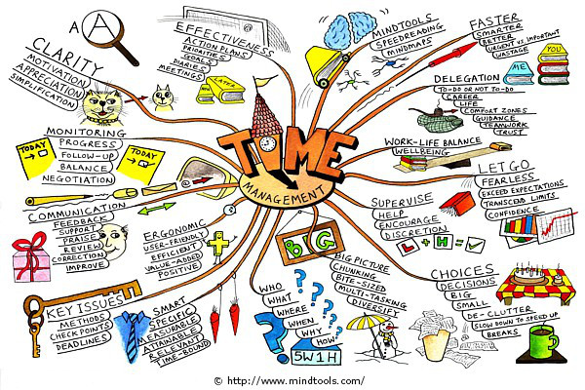

Slide 8
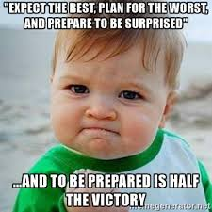
Class Materials
MANDATORY ITEMS
Notebook
loose paper
College-Ruled Composition Book (NOT Spiral)
Highlighters
post-it notes
pens/pencils
index cards
OPTIONAL ITEMS
Colored Pencils
Markers
Personal Device (i.e. Laptop, Tablet)
Tissues
Hand Sanitizer
Dry Erase Markers

Slide 9
10 minutes

Slide 10
Ap seminar Grading
Used to show personal growth
Typical to most courses
Skills Based Grades
Standards Grades

Slide 11
Skills Based Grades (seen in Powerschool)
60% Major: Larger Assignments including Annotated Bibliographies, Essays, Presentations
Assignments in this category can be redone according to the School Retest Policy.
All Minor assignments pertaining to each major assignment must be submitted prior to taking advantage of this opportunity.
The cap on the re-submittal is a 70%.
40% Minor: Smaller Assignments including work done associated with in-class discussions, homework, process writing, etc.
Assignments in this category can be re-submitted to demonstrate growth according to the School-wide late-work deadlines of Q2 (Monday, 12/3) for all assignments due prior to this date and Q4 (Monday, 4/29) for all assignments due after 12/3.
The cap on the re-submittal is a 60%.

Slide 12
Standards Based Grades (worked towards all year)
Standards Based Grades (See Attached: Standards) will be demonstrated by artifacts of student work. Artifacts will be derived from the various tasks, projects, and essays assigned over the course of the semester. At various intervals in the semester, students will apply for Standards evaluation. A form for Standard Application will be given out when needed in Quarter 1.

Slide 13
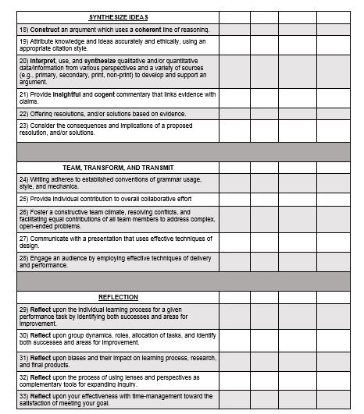

Slide 14
Midterm
Final exam
Due at the conclusion of 1st Semester (January)
Highest possible points: 35 pts (100%)
Due at the conclusion of course (June)
Highest possible points: 99+1=100 pts (100%)
Points accrued during the first semester will carry over towards the accumulation of points for the final exam. It is cumulative of the entire year!!

Slide 15
Note: Grades will be recorded in Powerschool as normal, but at the end of the 1st and 3rd quarters, a grade will not appear on the report card and a physical progress report will be sent home via the student with all Q1 and Q3 scores. Due to limitations in Powerschool this method will allow us to reflect growth within Q1 and Q3 in the subsequent scoring periods.

Slide 16
Integrity
Plagiarism Policy: (From the College Board)
It is expected that students will “ethically use and acknowledge the ideas and work of others throughout their course work. The student’s individual voice should be clearly evident, and the ideas of others must be acknowledged, attributed, and/or cited.
A student who fails to acknowledge the source or author of any and all information or evidence taken from the work of someone else through citation, attribution or reference in the body of the work, or through a bibliographic entry, will receive a score of 0 on that particular component of the AP Seminar and/or AP Research Performance Assessment Task. In AP Seminar, a team of students that fails to properly acknowledge sources or authors on the Written Team Report will receive a group score of 0 for that component of the Team Project and Presentation.
A student who incorporates falsified or fabricated information (e.g. evidence, data, sources, and/or authors) will receive a score of 0 on that particular component of the AP Seminar and/or AP Research Performance Assessment Task. In AP Seminar, a team of students that incorporates falsified or fabricated information in the Written Team Report will receive a group score of 0 for that component of the Team Project and Presentation.”
All College Board Deadlines are BINDING and NON-NEGOTIABLE. This supersedes any and all HHS practices regarding late-work deadlines.

Slide 17
Quarter 1 (September – October)
Space Race. A micro-unit designed to teach basic Capstone Skills, which includes establishing a thorough line of reasoning, developing compelling questions, understanding perspectives and lenses, and determining credibility of sources.
Health and Wellness. A macro-unit designed to simulate the requirements for College Board Performance Task 1 (PT1). This contains both individual and group elements (individual scores WILL BE affected by group performance which is in keeping with College Board Mandates). It will include an Individual Research Report (IRR), Group Presentation, and Oral Defense.

Slide 18
Quarter 2 (October – December)
Relationships and Interconnectedness. A macro-unit designed to simulate the requirements for College Board Performance Task 2 (PT2). This is an individual large project which entails an Individual Written Argument (IWA), a Presentation, and an Oral defense.

Slide 19
Note: At the conclusion of Quarter 2 the teacher can no longer offer direct one-on-one feedback. This is a mandate from College Board*. Starting with our Quarter 3 the students are working directly towards their AP Performance Tasks and Exam. There still may be general lessons to the class, but the majority of the remaining class time is working either on the group or independent portions of the AP Score (Performance Tasks 1 and 2).
*See the attached note from College Board in regards to the teacher’s role. This also applies to mentors, tutors, and parents who work with the students.

Slide 20
As provided by the College Board, in reference to the AP Seminar Course, the following explains the roles that a teacher may and may not take as students enter into the AP Graded portion of the course. This also applies to any non-high school student/adult who may wish to work with a student during the AP scored section of the course.

Slide 21
Teachers…
must ensure students are aware of the task, timeline, components, and scoring criteria
may explore issues, discuss topics and perspectives, and/or question students as necessary
oversee the formation of groups (Performance Task 1 only)
may continue whole-class teaching of skills pertinent to the performance task as students are working on their research and/or presentations
may share the rubric with students
may encourage students to review each other’s work

Slide 22
Teachers may not…
Assign, provide, distribute, or generate research questions for students
Conduct or provide research/articles/evidence for students
Write, revise, amend, or correct student work
Give specific, directive feedback to individual groups
Reveal defense questions to students prior to the presentation

Slide 23
Quarter 3 (December – February)
AP Seminar Performance Task 1 (PT1): Team report and presentation
The topic and essential question will be determined by the student teams and they will have at least 30 school days (equal to 15 classes on the block schedule) to complete the work. This will be submitted to the College Board for scoring after I complete my score. Each student will compile their own part of the project, which they will then put together as coherent whole as a written report and team presentation. While I can provide general help to the class, I can not give specific help to specific groups. At this point they will be expected to review each other’s work as well as consult other teachers based on the specific question they are researching.
**At this point the training wheels are off!**

Slide 24
Quarter 4 (December – February)
AP Seminar Performance Task 2: Individual report and presentation
In January, the College Board will send us a collection of articles loosely together in a theme. The students will then use on (or more) as a starting point to formulating the question they will research. They will have at least 30 school days (equal to 15 classes on the block schedule) to complete the work. This will be submitted to the College Board for scoring after I complete my score. Even though each student is completing their own project, they will be expected to review each other’s work as well as consult other teachers based on the specific question they are researching.
**At this point the training wheels are off!**

Slide 25
Here at Heritage High School we use our skills from AP Seminar to enhance our growth mindset pertaining to ourselves, our cultures, our local community, and society at large, in hopes of helping to create a better future for ourselves and generations to come!

Slide 26
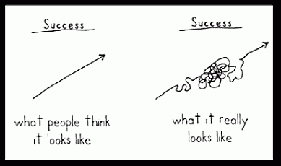
You WILL FAIL at times…that is OKAY!! We all must face challenges to learn and grow as people ☺

Slide 27
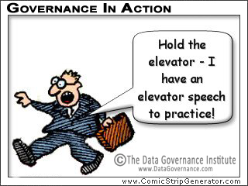
Before I see you again…
Make sure you have completed the School’s Summer Reading Assignment of reading Freakonomics.
The next time we are in class we will be having a Talking Day! Come ready to participate!! ☺
“Elevator Speech”: Prepare a 1 minute speech that you will give to the class on our 3rd meeting together (after the talking day). This is a pitch of yourself to the class so include anything you see pertinent that your peers know about you, as you will be choosing lots of groups throughout the course of the year.
Thoroughly read the syllabus and supporting documents.
Get all documents (green, pink, gold) signed in ALL places.

