Slide 1
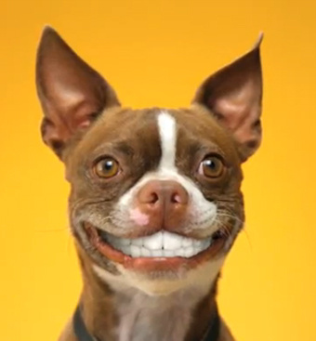
Warm-up
Go put your cell phone in the holder at the back of the room. Your phone should be left in the spot that corresponds to the number on your desk. You are just doing this for today. You are NOT in trouble ☺
Please place your homework packet facedown on the corner of your desk.
If you brought in your gold form that should be on top of your homework packet.
Take out a pencil, and nothing else.

Slide 2
Pre-assessment
Goal: Show me all that you know of the provided problems!
No Calculator allowed
You must attempt every problem. Show me all work that you use to arrive at your answers.
This pre-assessment’s purpose is two-fold:
It will tell me as your teacher which topics we know well as a class already, and which ones we need to spend more time reviewing.
You will take the assessment again later in the semester to see your personal growth.
Note: This is all MATH 1 Content, so it should at least look familiar ☺

Slide 3
Homework Answers!
$x=−1$
$y=28$
$m=5$
$x=0$
$y=\frac{4}{3}$
$p=7$
$y=−17$
$x=41$
#11: $Answer:−3$

Slide 4
Whiteboard Practice!!
Work the problem out entirely on your whiteboard.
Once you are finished turn the board face-down until we move on to the next problem.
This activity is self-assessed. You are to keep a tally in the top right corner of how many problems you work out entirely correct.
Feel free to ask questions if you are unsure about one of the problems! ☺

Slide 5
Problem 1
$$v=−2$$

Slide 6
Problem 2
$$k=3$$

Slide 7
Problem 3
$$r=5$$

Slide 8
Problem 4
$$n=−5$$

Slide 9
Problem 5
$$v=−1$$

Slide 10
Problem 6
$$k=−3$$

Slide 11
Problem 7
$$5\left(p+2\right)−3p−2\left(p+4\right)=2$$
$$∞$$

Slide 12
Problem 8
$$x=−2$$

Slide 13
Problem 9
$$∅$$

Slide 14
Problem 10
$$x=−3$$

Slide 15
Unit 1 Day 3
Intro to Word Problems

Slide 16
Basic Word Problems

Slide 17
Classwork: Challenge Section of Handout
Fold your paper into 9 rectangles.
Put your first and last name on the top right corner.
For each problem I should see:
Problem Number
Original Equation set up
Work for solving
Final answer boxed or circled

Slide 18
HOMEWORK ASSIGNMENTS
HW 1.3
Form if not already returned
Start studying for Friday’s quiz!

