Slide 1


Welcome to Special Topics (Math Plus)!!
Mrs. Perry
On your index card:
Name (First & Last)
Parent(s) names, Phone #, & Email
Do you play any sports or participate in any after school activities?
Copy down your schedule for my records.
On the back – Draw me a picture of something that you did this past summer.

Slide 2

Instructor Information
Email: koperry@wcpss.net
Website: This is important!!
mskoverton.weebly.com (see welcome letter)
Please allow 48 hours to respond to email.
If you email me, it must be from a wake county email address. Otherwise, I cannot respond!

Slide 3
Class Procedures and Boundaries
A warm-up will be given everyday. Get started on it when you walk in the door. You need to keep all warm-ups together. They may be collected at the conclusion of each unit.
Sharpen your pencil at the beginning of class.
Take care of going to the bathroom before class starts.
Ask before simply getting out of your seat.
Pick up assigned calculator as you walk in the door.
Do not touch things that aren’t yours. RESPECT OTHER PEOPLE AND THEIR THINGS! ☺
You are tardy when the bell rings and you aren’t in the door. You MUST bring in a tardy note for this!
Do not ask to go to the bathroom during class, unless you have an emergency.

Slide 4
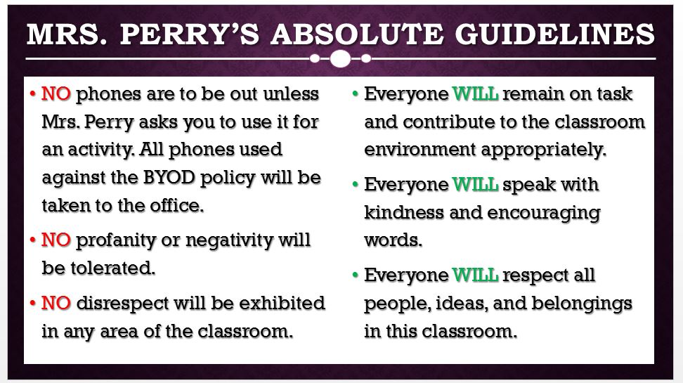

Slide 5

Supplies you will need…
Required Items:
TI-84 Plus graphing calculator
3-Ring binder - about 1.5”
Dividers
Loose-leaf paper
Graph paper
Spiral Ring Composition Notebook (to keep homework and misc. classwork)
Pencils
Preferred Items:
Dry Erase Markers
Colored Pencils/Markers
Highlighters
Ruler
Compass
Hand Sanitizer
Tissues

Slide 6
Grading Policy
Major 60% Minor 30% HW 10%
There will be a State Final Exam which counts for 20% of the final course grade!!

Slide 7
Make Up Policy
Heritage HS allows students to complete missed homework and project assignments for 60% of the earned grade, if completed by pre-set Make-up deadlines. These deadlines occur mid-quarter and prior to midterm/final exam periods each quarter. No late work may be turned in past these deadlines. Late Classwork is NOT ACCEPTED per School Policy (unless students were absent on the day it was assigned).

Slide 8
Re-Test Policy (Heritage HS-wide policy):
Students may be re-assessed on any and all tests throughout an academic quarter.
The re-assessment may not be in the same form as the original test. The highest possible grade for a retake is a 70%.
In order to qualify for a re-assessment, each student must…
Have every homework assignment for the given unit completed by the re-test date.
Complete the re-test on the date chosen by the teacher (within a week of having the test returned to the student).
Remediate with the teacher on the material prior to the re-test.

Slide 9
Quiz Replacement Policy
(Math Dept. policy):
It is the philosophy here at Heritage HS that assessments are given in an attempt to see where each student is at in their learning, and make adjustments to further their education. Therefore, if a student performs better on a unit test than they did on a quiz within this unit, they may replace their lowest quiz grade with the better unit test grade.
Only original test scores may replace quiz scores, not re-test scores.

Slide 10
Husky Help
Husky Help will run Monday – Thursday. Each student in the class that has a C, D, or F (anything below 80%) in the course on that given day (according to their weekly progress report), will be mandated to attend this remediation session (built in to the school day).
Monday – 1st Period Tuesday – 2nd period
Wednesday – 3rd Period Thursday – 4th period
All other students will have the opportunity to participate in intramural sports, attend career or college sessions, work individually or with groups on assignments in the Media Center or the Commons, or meet with Student Service counselors for academic planning.

Slide 11
Internet Safety
In accordance with Board Policy 2313/3013/4013 and the 21st Century Act (Public Law No: 110:385, Oct. 10, 2008) all students will be trained annually in Internet safety. School districts are required to educate students about:
Appropriate online behavior, including interacting with other individuals on social networking websites and in chat rooms.
Cyber bullying awareness and response.

Slide 12
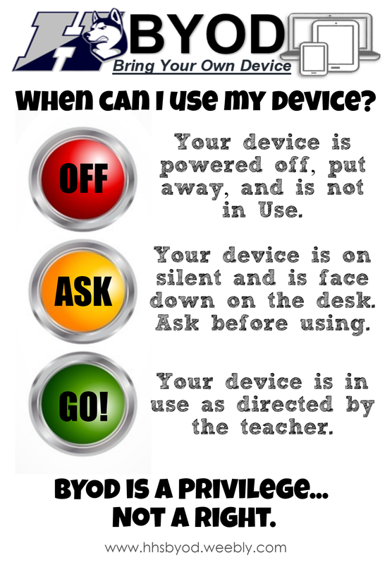

Slide 13

Course Skills
This class is designed to encourage COLLABORATION, CRITICAL THINKING, COMMUNICATION, and CREATIVITY.
These are foundational skills utilized throughout the course to create for a well-rounded student who is equipped to face any challenge with an open mind, whether it be in the math classroom or another discipline.
We will start building these skills today!!

Slide 14

Special Topics
Unit 1 Day 1 Notes
Mrs. Perry
Expressions

Slide 15
Key Vocabulary
____________________: A mathematical phrase that can include numbers, variables, and operation symbols (ex. 3y + 7)
__________________: A number that is multiplied by a variable (ex. 5x)
______________: A value that does not change (ex. 4)
_____________________: For every real number a, b, and c: a(b + c) = ab + ac and a(b-c) = ab – ac (ex. 4(x + 3) = 4x + 12)
_______________________: Expressions that have the same value for all variables
_____________: Positive and negative whole numbers (ex. 22, -3)
__________________: Have identical variables; that is, they have the same variable to the same exponent. Constants are like terms as well. (ex. 6x² and 99x² are like terms)
___________________: Parenthesis, Exponents, Multiplying and Dividing (left to right), Adding and Subtracting (left to right) PEMDAS!
_______________: To write an expression in simplest form (combine all like terms)
_________________: To replace a letter with a number or algebraic expression
_______________: “parts” in an expression that are added or subtracted (ex. 4x² + 3 -> 4x² and 3 are terms)
______________: a letter that represents an unknown number

Slide 16
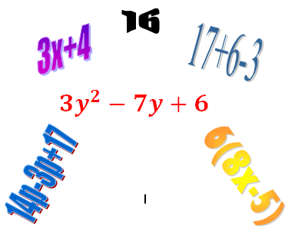
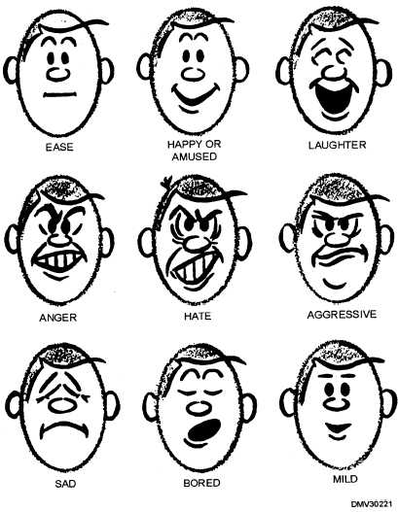
In the social world…
An expression is a facial gesture that shows the emotion that a person is feeling.
In the math world…
An expression is a set of terms which is connected by mathematical operations.

Slide 17
Writing Expressions
Goal: Look for key words that you can associate with different math operations to convert the written phrase into an algebraic expression
Common key words:
sum, difference, plus, minus, product, quotient, less than, more than….

Slide 18
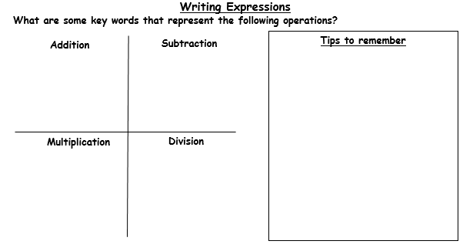

Slide 19
Let’s do some together ☺
13 + v
Thirteen plus v
Three times d
The difference of h and 8
23 divided by y
$18 less than the sale price
3d
h - 8
23 / y
s - 18

Slide 20


Now you try!!
3 minutes
The quotient of n and 12
8 less than 25 multiplied by a number q
3 more than the difference of 20 and a number m
10 plus a number s times 5
10 less than the quantity j multiplied by 44
Challenge: 5 less than the quotient of a number and 16

Slide 21
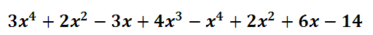





Simplifying Expressions
Goal: Combine all like terms (terms that have the same variable and degree/exponent)
**Always leave simplified expression in standard form with the exponents decreasing in power from left to right
Example:
Final Simplified Expression

Slide 22
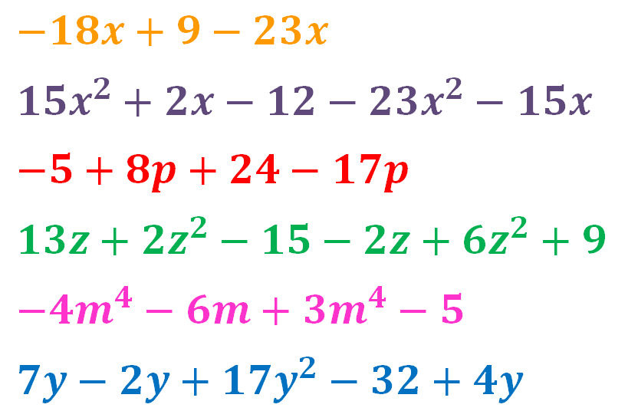
Try some with your partner ☺
5 minutes
End

Slide 23


Distributive Property
When distributing, take the term on the outside of the parenthesis and multiply it to each term inside the parenthesis.
**Be sure to pay close attention to the signs!!
Example:
Note: The final expression should always be simplified and in standard form!

Slide 24
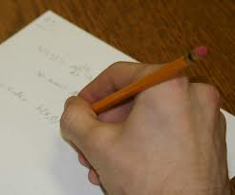
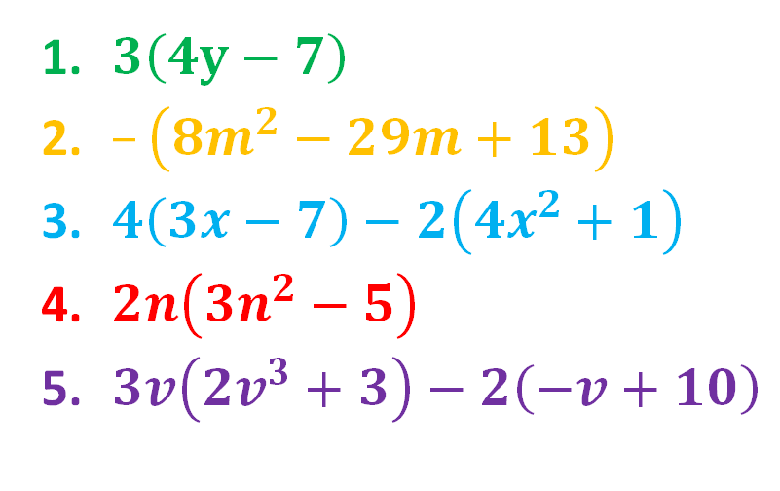
Independent Practice
End
4 minutes and go!

Slide 25




When multiplying expressions we simply use the distributive property several times…
Don’t forget to combine like terms and put it in standard form!!

Slide 26



Let’s do a few together! ☺

Slide 27




Your turn!!
5 minutes

Slide 28
Homework
HW 1.1,
Diversity quilt, and forms
******************************
Tutorials
All Husky Help Times
Tuesday afternoon
2:30-3:30 pm

